Slide 1
AJAX

Slide 2
Introduction
Asynchronous javascript and XML.
It is not a programming language
AJAX just uses a combination of:
A browser built-in XMLHttpRequest object (to request data from a web server).
Javasccript and HTMML DOM (display or use the data
AJAX allows web pages to be updated asynchronously by exchanging data with a web server behind the scenes. This means that it is possible to update parts of a web page, without reloading the whole page.

Slide 3
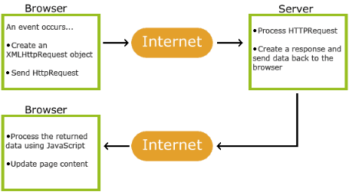
HOW AJAX WORKS ?

Slide 4
An event occurs in a web page (the page is loaded, a button is clicked)
An XMLHttpRequest object is created by JavaScript.
The XMLHttpRequest object sends a request to a web server
The server processes the request.
The server sends a response back to the web page.
The response is read by JavaScript
Proper action (like page update) is performed by JavaScript

Slide 5
The XMLHttpRequest Object
Create an XMLHttpRequest object
Define a callback function
Open the XMLHttpRequest object
Send a Request to a server

Slide 6
Create an XMLHttpRequest Object:
All modern browsers support the XMLHttpRequest object.
All modern browsers (Chrome, Firefox, IE, Edge, Safari, Opera) have a built-in XMLHttpRequest object.
Syntax:
variable = new XMLHttpRequest();
Define a call back function:
A callback function is a function passed as a parameter to another function.

Slide 7
the callback function should contain the code to execute when the response is ready.
Syntax:
xhttp.onload = function() {
// What to do when the response is ready }
Send A Request:
To send a request to a server, you can use the open() and send() methods of the XMLHttpRequest object:
Syntax:
xhttp.open("GET", "ajax_info.txt");
xhttp.send();

Slide 8
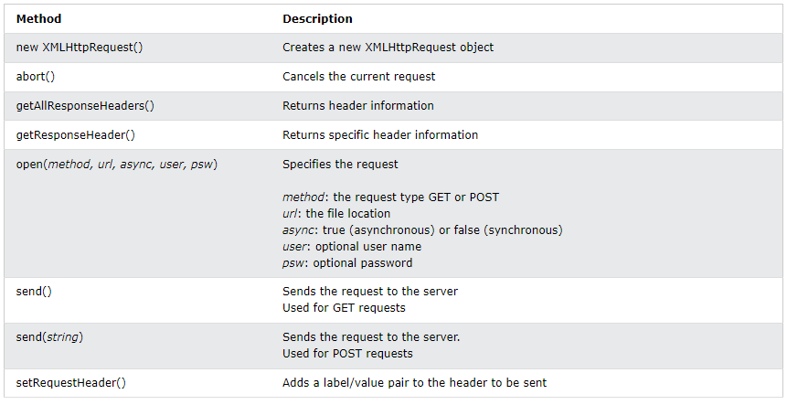
XMLHttpRequest Object Methods

Slide 9
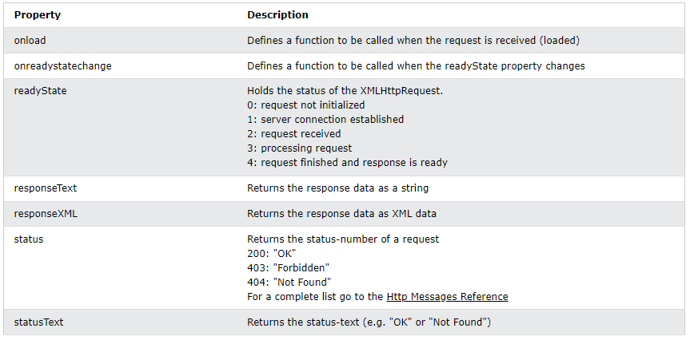
XMLHttpRequest Object Properties

Slide 10
Onload property
The XMLHttpRequest object you can define a callback function to be executed when the request receives an answer.
The function is defined in the onload property of the XMLHttpRequest object:
Eg: xhttp.onload = function() { document.getElementById("demo").innerHTML =
this.responseText; } xhttp.open("GET", "ajax_info.txt"); xhttp.send();

Slide 11
The onreadystatechange Property
The readyState property holds the status of the XMLHttpRequest.
The onreadystatechange property defines a callback function to be executed when the readyState changes.
The status property and the statusText properties hold the status of the XMLHttpRequest object.
The onreadystatechange function is called every time the readyState changes.

